Slide 1

A n a l y s I s
on Movie
By：Yijun Wang

Slide 2

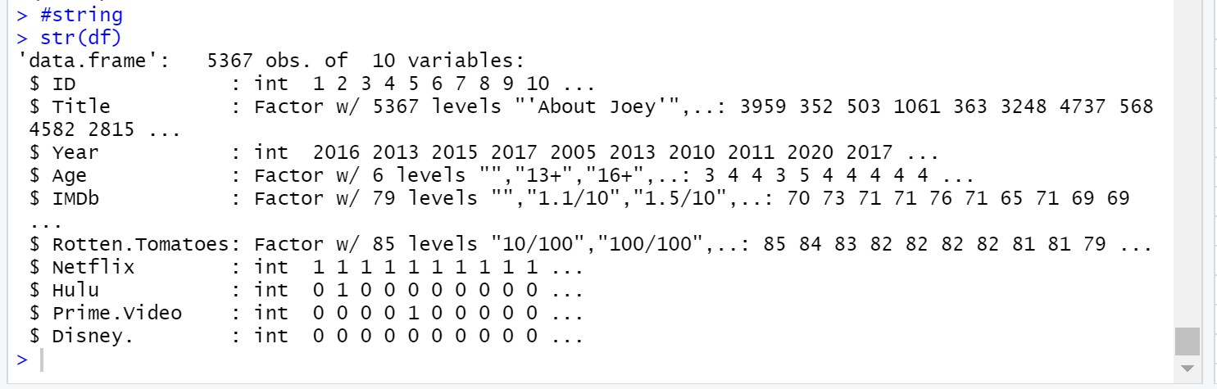
Summary
This dataset contains 10 variables, 4 service platform
- Netflix,
- Hulu,
- Prime.Video
- Disney.
Notes:
#string
str(df)

Slide 3
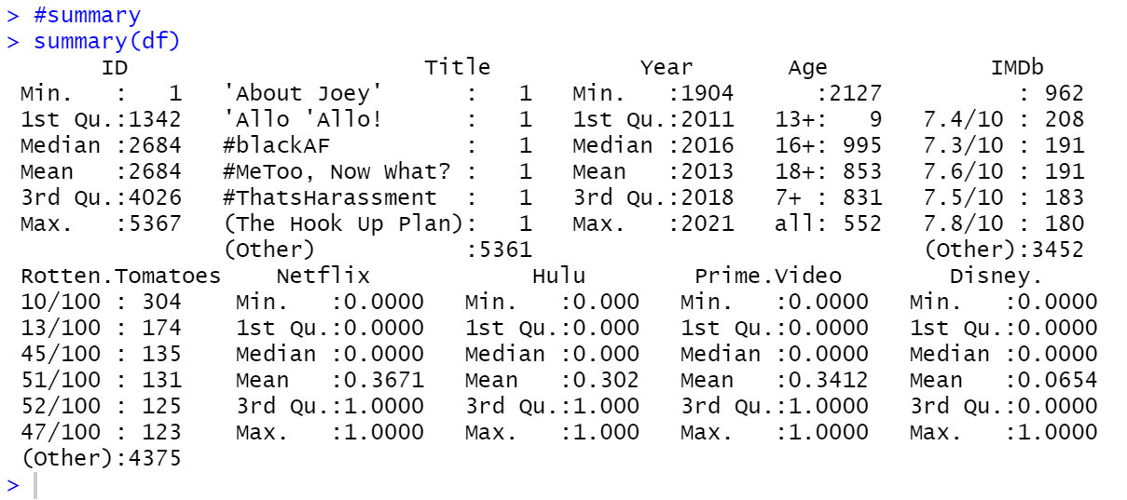
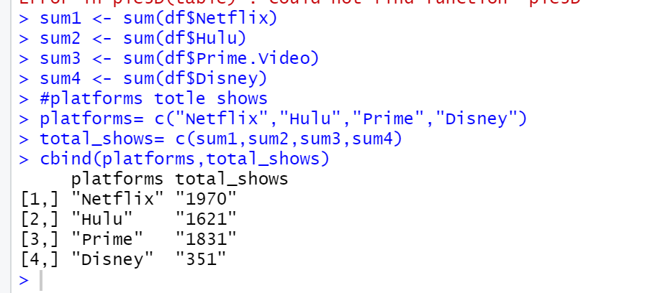
Found
Total 5367 ID in this dataset.
962 IMDbs did not rate the movie
Each platform’s movie count
-Netflix: 1970
-Hulu: 1621
-Disney: 351
-Prime.Video: 1831
Notes:
#summary
summary(df)
#sum
sum1 <- sum(df$Netflix)
sum2 <- sum(df$Hulu)
sum3 <- sum(df$Prime.Video)
sum4 <- sum(df$Disney)
#platforms totle shows
platforms= c("Netflix","Hulu","Prime","Disney")
total_shows= c(sum1,sum2,sum3,sum4)
cbind(platforms,total_shows)

Slide 4
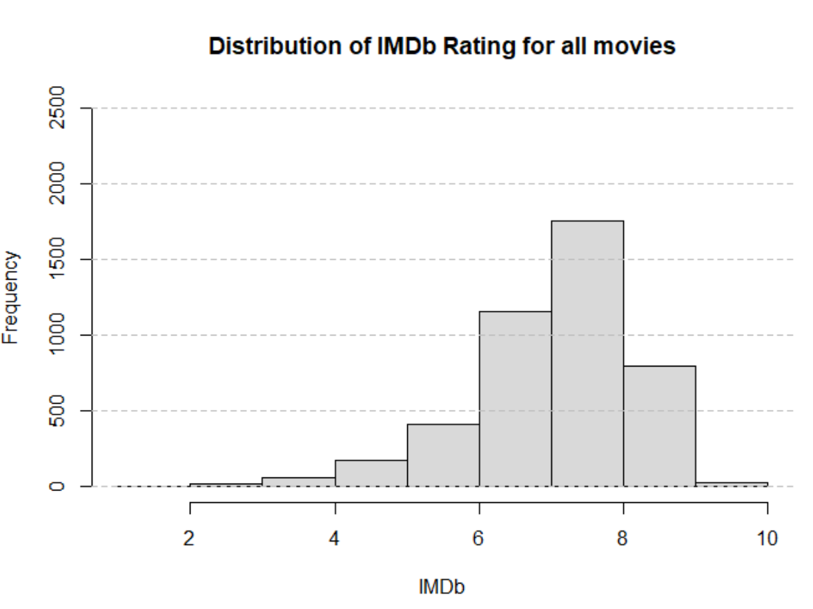
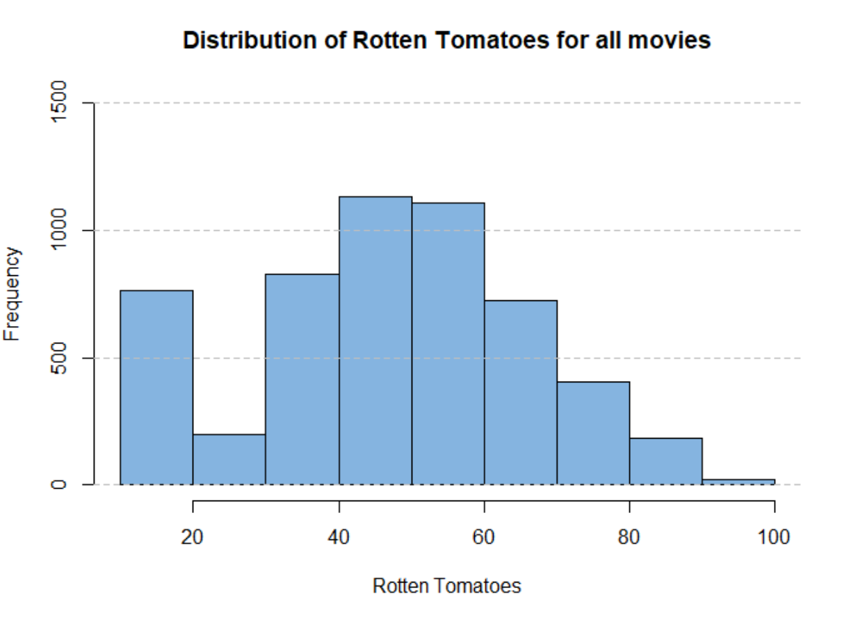

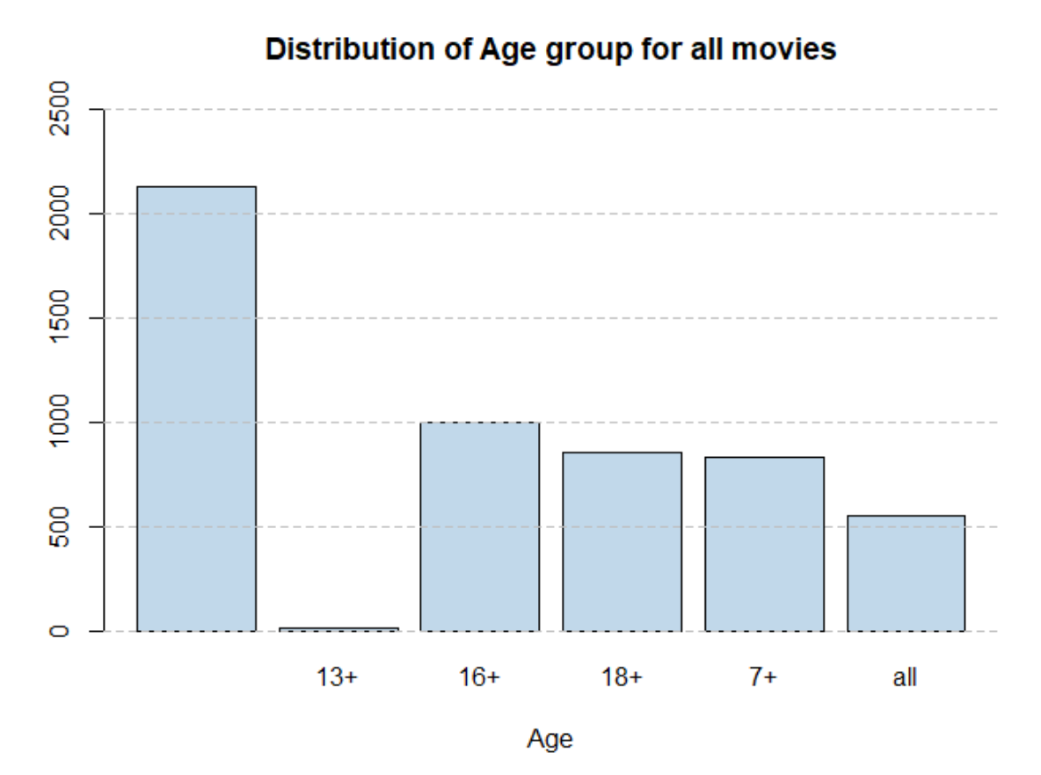
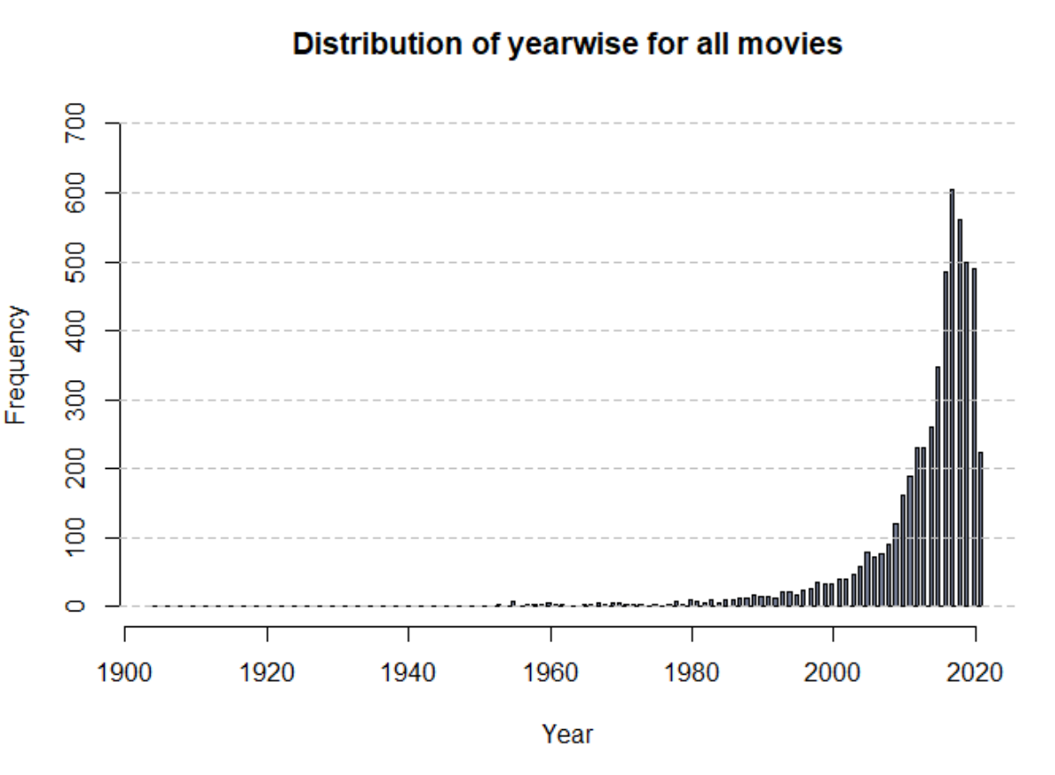
IMDb’s high frequency is between 6.0 and 8.0.
Rotten Tomatoes’s lowest frequency are between 20-30, 90-100
Visualize from different aspect
Age’s null data has the most frequency, but not accurate( no consider)
Year’s high frequency is between 2010 and 2020.
Notes:
#Histgram of IMDb
hist(df$IMDb,col= "#D9D9D9",
main= "Distribution of IMDb Rating for all movies",xlab= "IMDb",breaks= 7,
ylim= c(0,2500))
grid(nx= NA, ny= NULL, lty= 2, col= "gray", lwd= 1)
#Histgram of Rotten Tomatoes
hist(df$Rotten.Tomatoes,col= "#85B4E0",
main= "Distribution of Rotten Tomatoes for all movies",xlab= "Rotten Tomatoes",
breaks= 7, ylim= c(0,1500))
grid(nx= NA, ny= NULL, lty= 2, col= "gray", lwd= 1)
#Plot of Age
plot(df$Age,col= "#C1D8EA",
main= "Distribution of Age group for all movies",xlab= "Age",breaks= 7,
ylim= c(0,2500))
grid(nx= NA, ny= NULL, lty= 2, col= "gray", lwd= 1)
#Histgram of Year
hist(df$Year,col= "#727a93",
main= "Distribution of yearwise for all movies",xlab= "Year",breaks= 200,
ylim= c(0,5000))
grid(nx= NA, ny= NULL, lty= 2, col= "gray", lwd= 1)

Slide 5
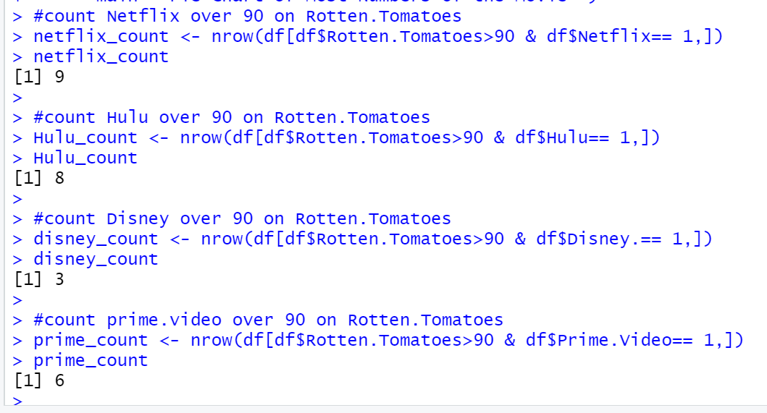
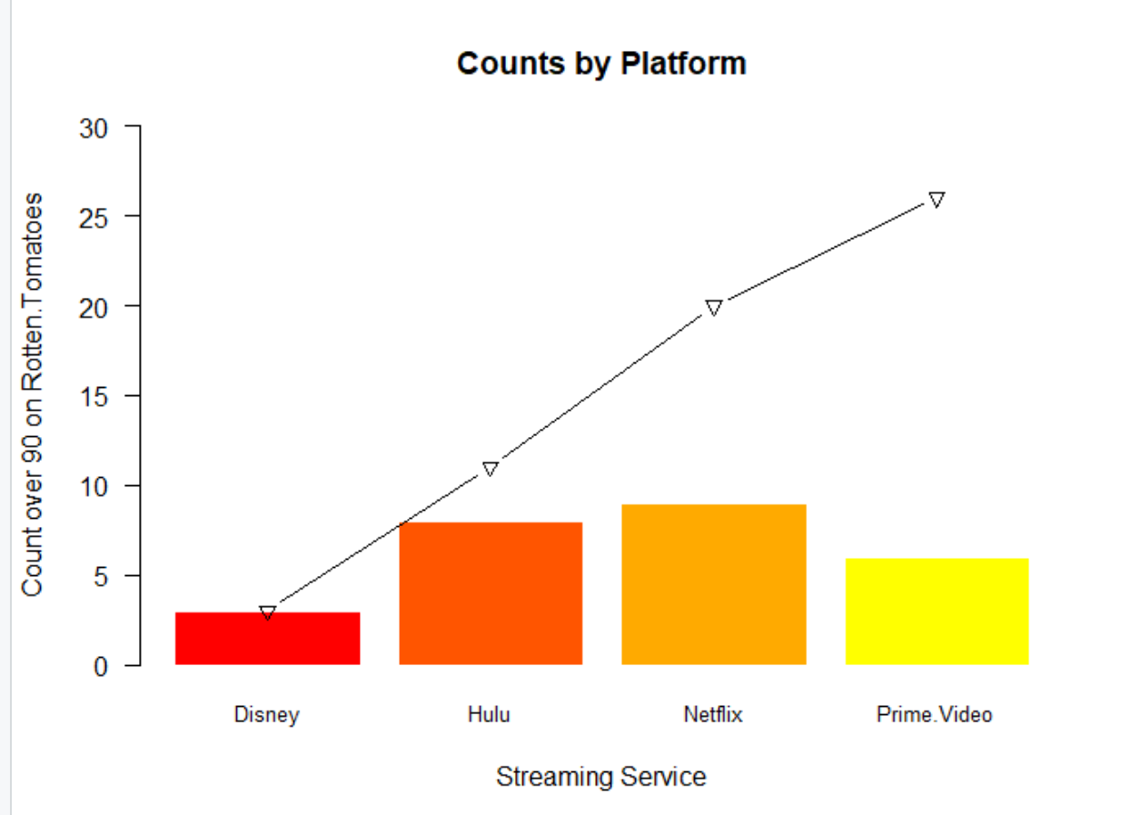
Hulu and Netflix’s count are more than other platform. counts line
Rotten Tomatoes
Notes:
#count Netflix over 90 on Rotten.Tomatoes
netflix_count <- nrow(df[df$Rotten.Tomatoes>90 & df$Netflix== 1,])
netflix_count
#count Hulu over 90 on Rotten.Tomatoes
Hulu_count <- nrow(df[df$Rotten.Tomatoes>90 & df$Hulu== 1,])
Hulu_count
#count Disney over 90 on Rotten.Tomatoes
disney_count <- nrow(df[df$Rotten.Tomatoes>90 & df$Disney.== 1,])
disney_count
#count prime.video over 90 on Rotten.Tomatoes
prime_count <- nrow(df[df$Rotten.Tomatoes>90 & df$Prime.Video== 1,])
prime_count
#Barplot of over 90 on Rotten.Tomatoes
names<-c("Disney","Hulu","Netflix","Prime.Video")
counts<-c(disney_count,Hulu_count, netflix_count,prime_count)
p <-barplot(counts,names.arg= names,las= 1,cex.names= 0.8, ylim= c(0,30),
main= "Counts by Platform",col= heat.colors(5),border= "white",
ylab= "Count over 90 on Rotten.Tomatoes",
xlab= "Streaming Service")
cum_sums<-cumsum(counts)
lines(p, cum_sums, type= 'b', pch= 6, col= 'black')

Slide 6
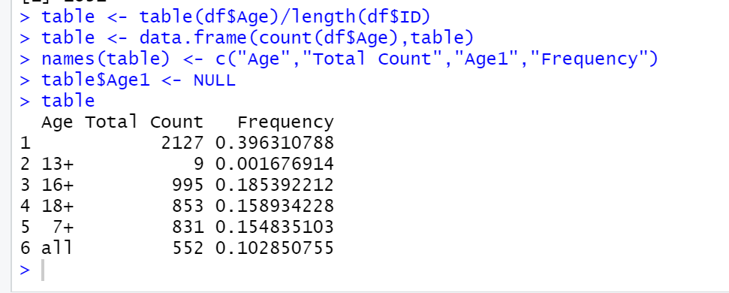
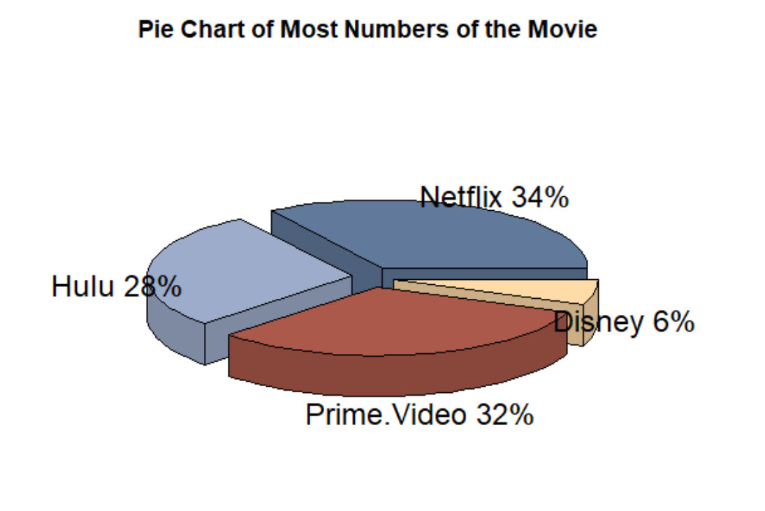
Netflix has the greatest amount of movies for children
Add “Frequency” to see how different Age’s distribution
Age
First Age is missing number, which has 2127 total (39%)
The total number of 16+ is the most! ( Because of Age is string, so can’t calculate the average and median number)
Netflix has the biggest: 34%
Prime.Video has 32%
Hulu has 28%
Disney has 6%
Notes:
#3D PIE CHART: the Service has the highest number of the movie
slices <- c(sum1,sum2,sum3,sum4)
lbls <- c("Netflix", "Hulu", "Prime.Video", "Disney")
pct <- round(slices/sum(slices)*100)
lbls <- paste(lbls, pct)
lbls <- paste(lbls,"%",sep= "")
colors <- c("#61799b", "#9daccb", "#ab594b", "#ffdba7")
pie3D(slices,labels= lbls,explode= 0.1,col= colors,
main= "Pie Chart of Most Numbers of the Movie ")

Slide 7
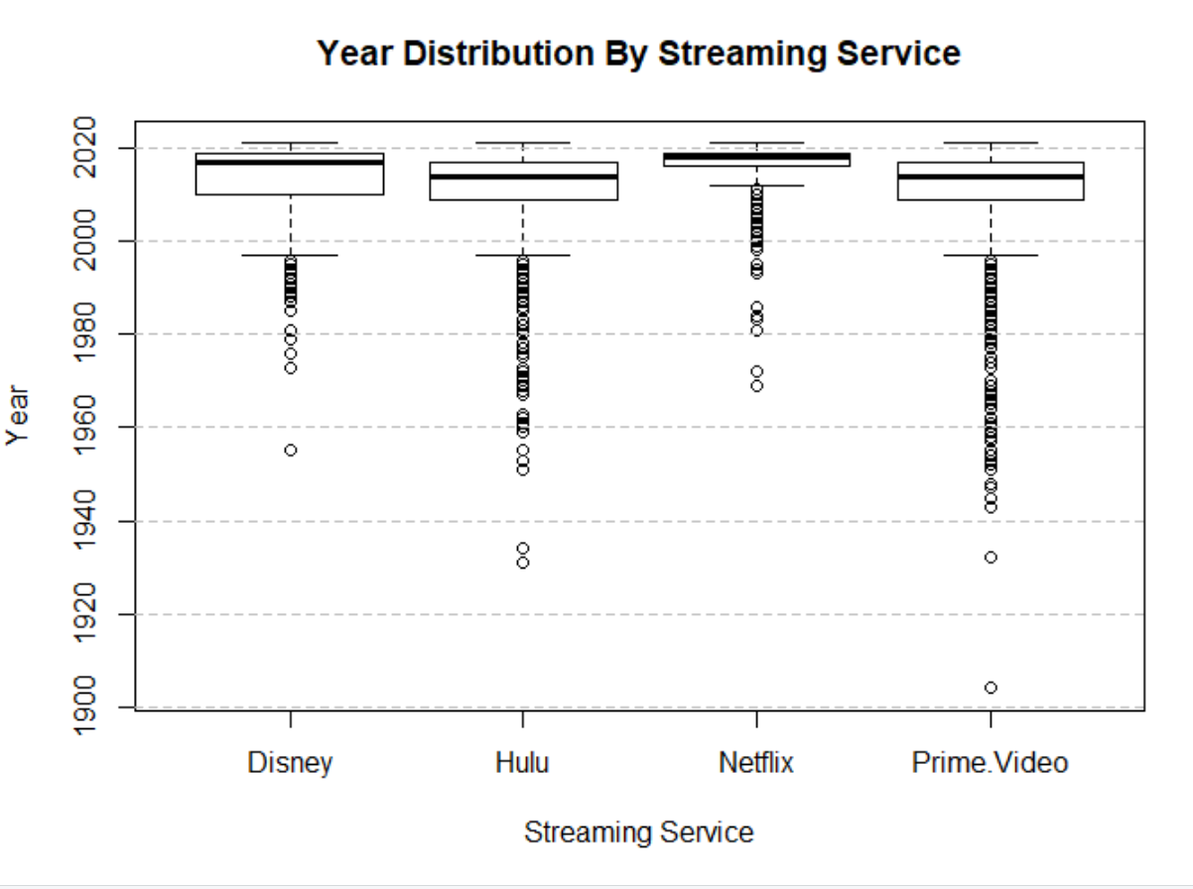
Distribution of year Release
Median line, represents the sample dataset's average level.
-Netflix’s is the highest.
out of range point, indicating that an outlier exists.
- Prime.Video has the most outlier point
Skewed
-Disney: Left- Skewed
- Hulu: Left- Skewed
-Prime.Video: Left- Skewed
Notes:
#Boxplot of 4 Platform's year
list <-list(D$Year,H$Year,N$Year,P$Year)
boxplot(list, main= "Year Distribution By Streaming Service",
xlab= "Streaming Service",ylab= "Year",names= names)
grid(nx= NA, ny= NULL, lty= 2, col= "gray", lwd= 1)

Slide 8
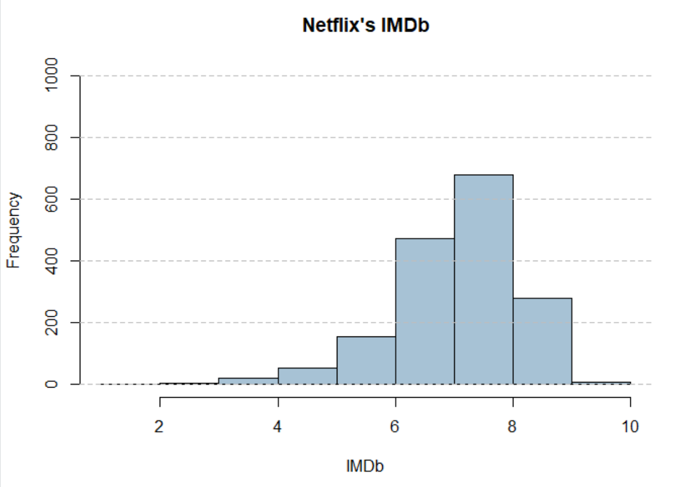
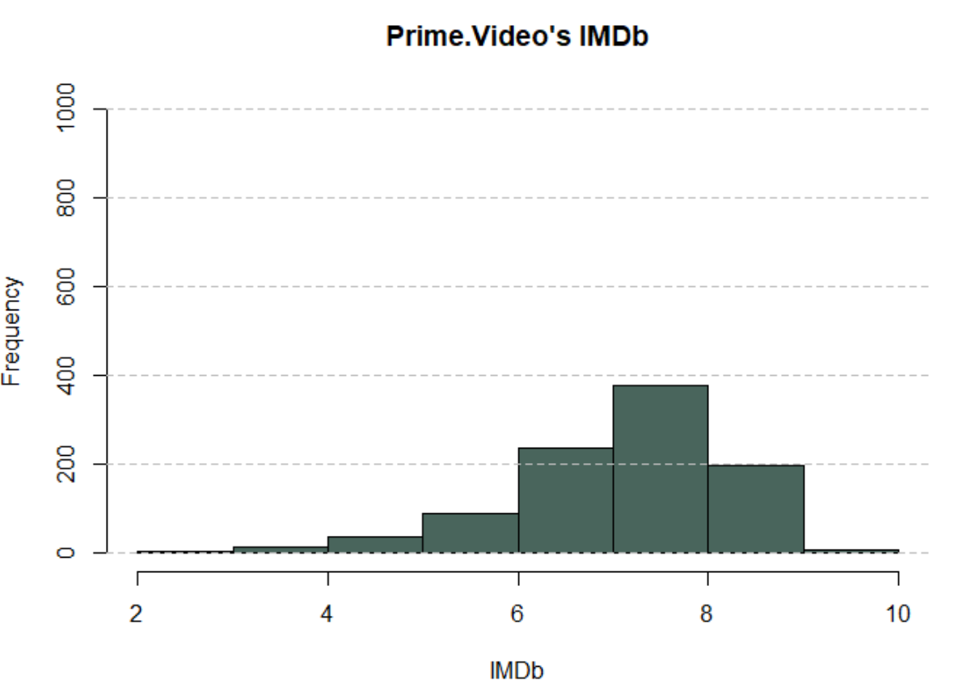
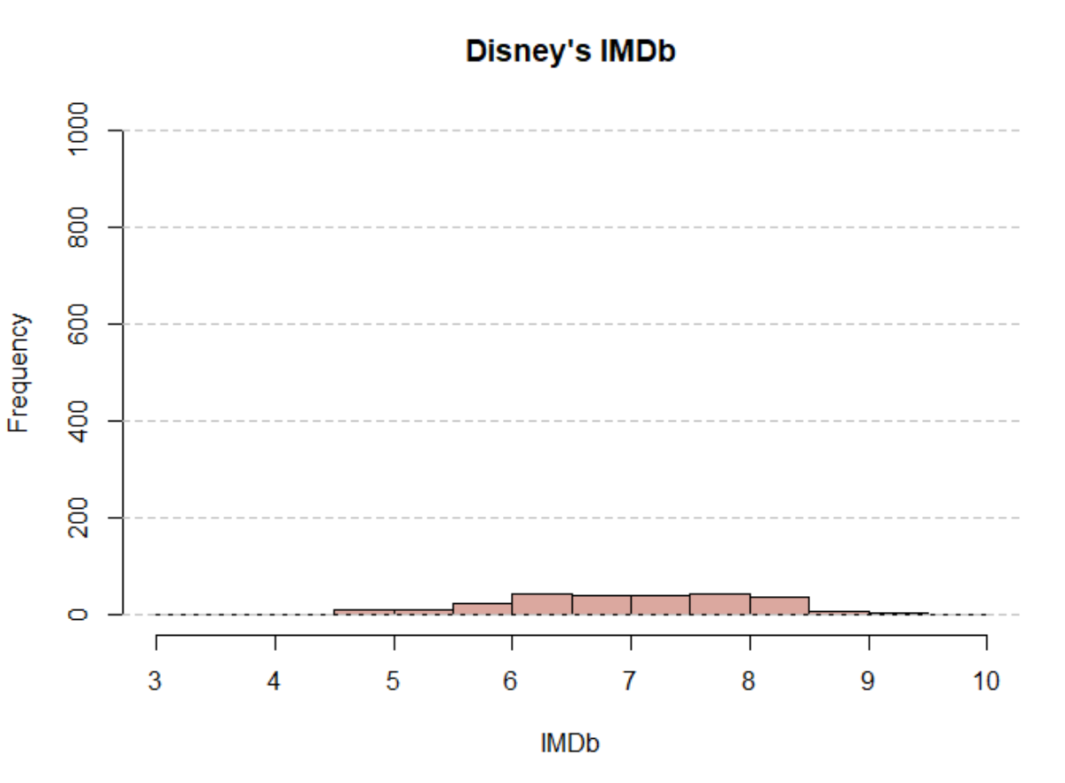
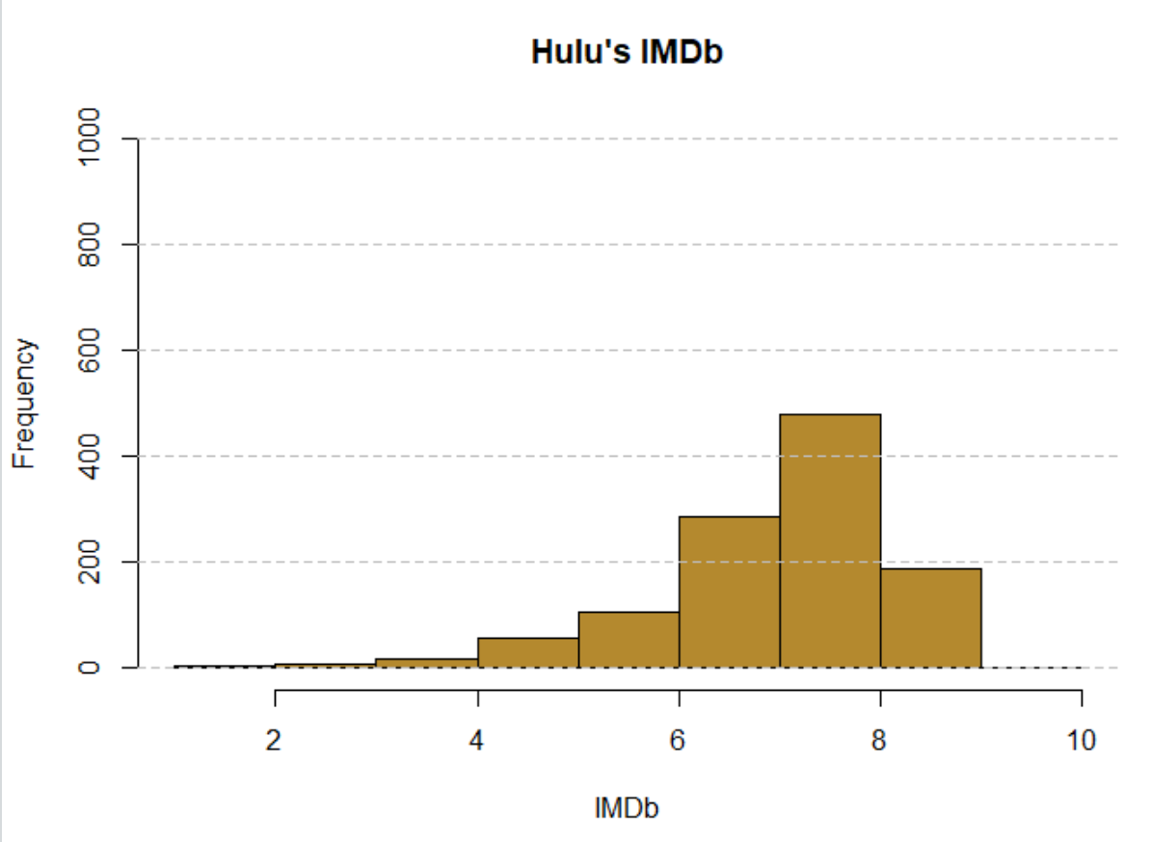
Prime.Video reign supreme in the sense of having access to the most highly rated tv-shows.
Followed by Netflix and Hulu who are nearly equal.
No surprise Disney have significantly the least number of highly rated tv-shows
IMDb
Netflix’s average IMDb: 7.109
Hulu’s average IMDb: 7.0823
Disney’s average IMDb: 6.971
Prime.Video’s average IMDb: 7.152
Notes:
#Distribution of Netflix
hist(N$IMDb,col= "#a7c2d5",
main= "Netflix's IMDb",
xlab= "IMDb", ylim= c(0,1000),breaks= 10)
grid(nx= NA, ny= NULL, lty= 2, col= "gray", lwd= 1)
#Distribution of prime.Video
hist(P$IMDb,col= "#49655c",
main= "Prime.Video's IMDb",
xlab= "IMDb", ylim= c(0,1000),breaks= 10)
grid(nx= NA, ny= NULL, lty= 2, col= "gray", lwd= 1)
#Distribution of Disney
hist(D$IMDb,col= "#dba89f",
main= "Disney's IMDb",
xlab= "IMDb", ylim= c(0,1000),breaks= 10)
grid(nx= NA, ny= NULL, lty= 2, col= "gray", lwd= 1)
#Distribution of Hulu
hist(H$IMDb,col= "#b4892e",
main= "Hulu's IMDb",
xlab= "IMDb", ylim= c(0,1000),breaks= 10)
grid(nx= NA, ny= NULL, lty= 2, col= "gray", lwd= 1)

Slide 9

Conclusion
Although Prime Video has the highest average rating on IMDb, Netflix is the best option if you value quality over IMDb. The platform with the most films published in the last ten years and over 90% Rotten Tomatoes approval.
On the other hand, if you want to meet the needs of your children, Disney+ is a fantastic subscription because it is specifically designed for them.

Slide 10


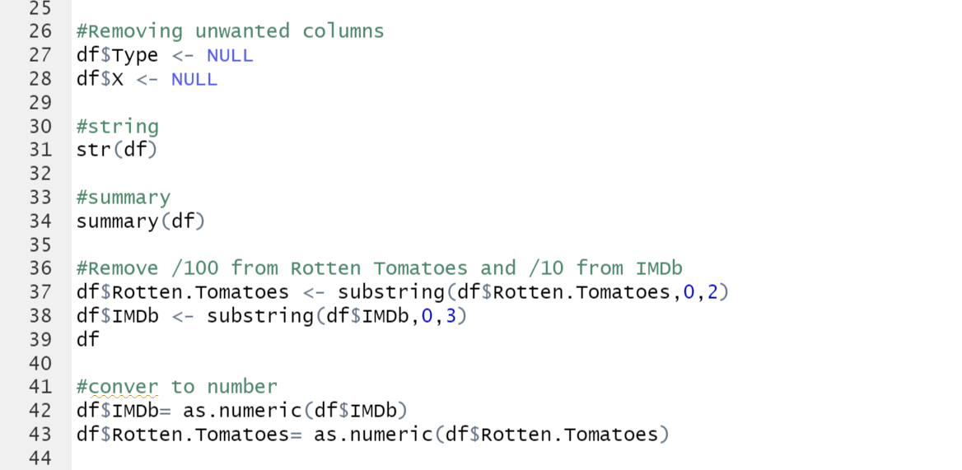
Code

Slide 11

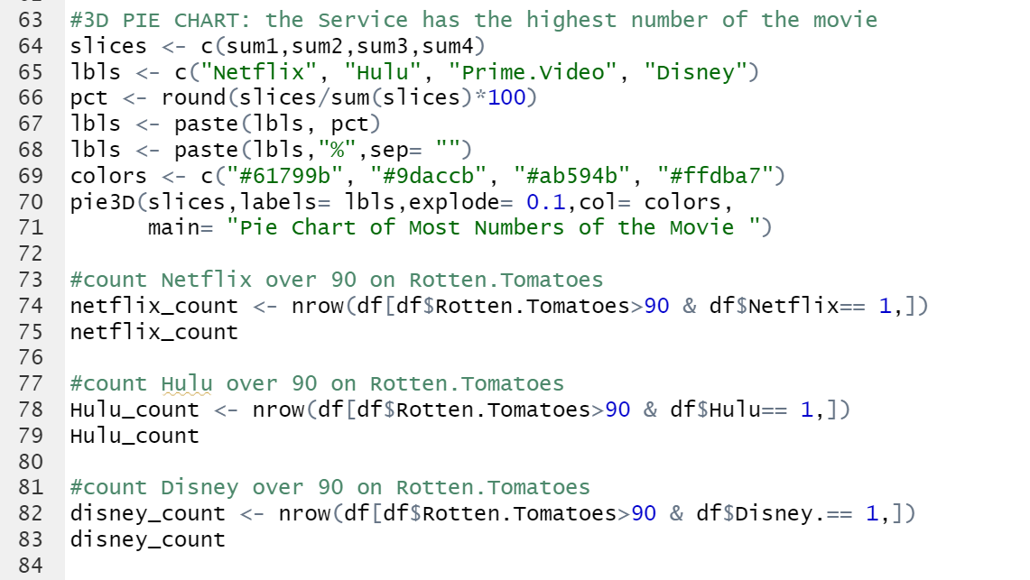
Code

Slide 12
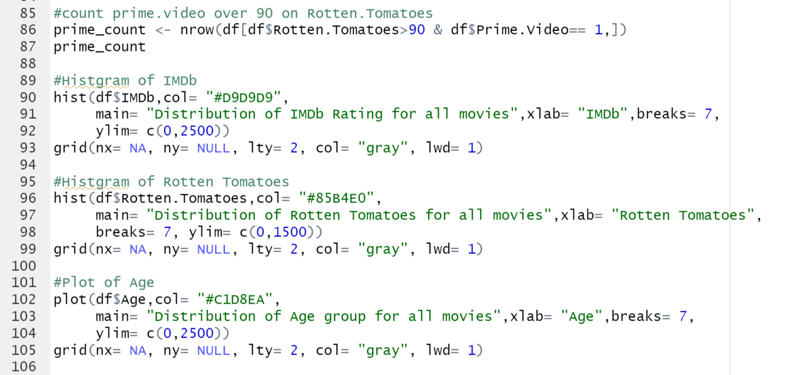
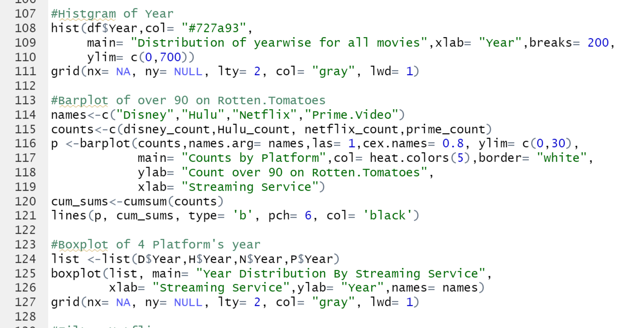
Code

Slide 13
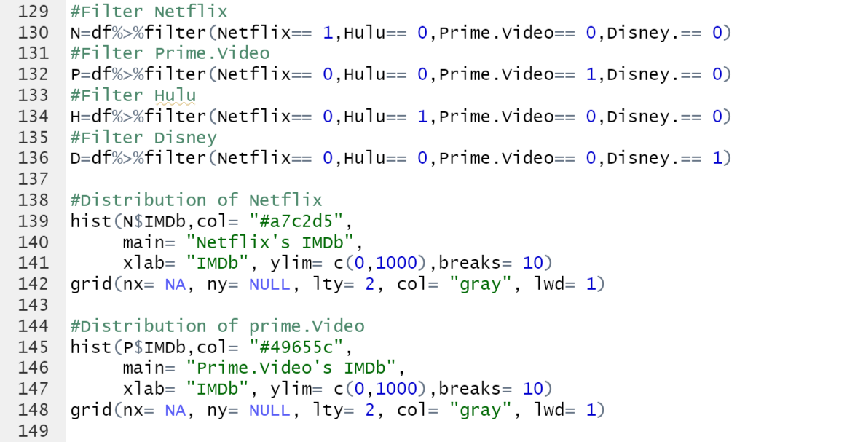
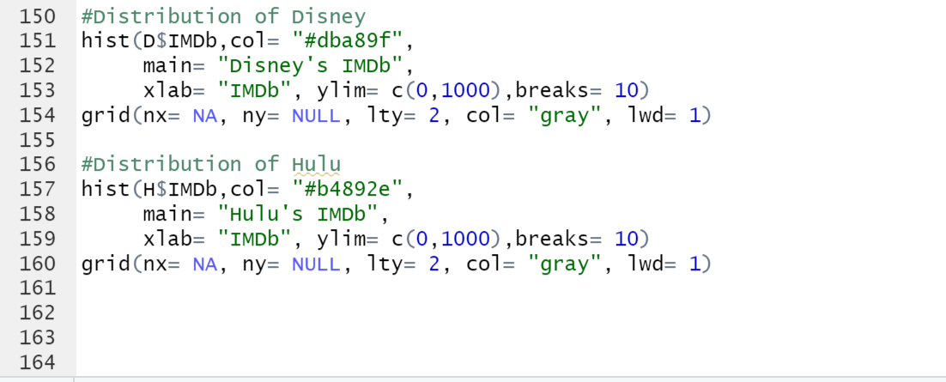
Code

Slide 14

THANKS
Yijun Wang

Slide 15

